Slide 1

PROGRAMMING FUNDAMENTALS
FALL 2023

Slide 2
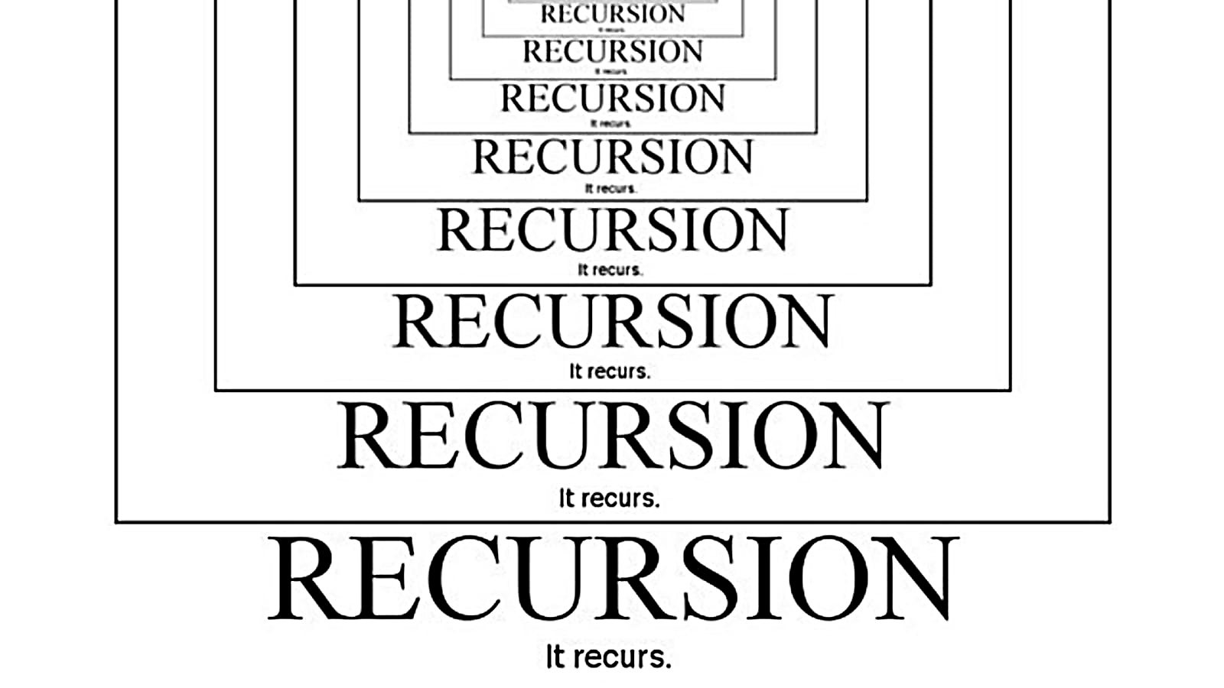
WEEK 10

Slide 3
#include <stdio.h>
int count=0;
void df(){
printf("%d\n",++count);
if(count<10)
{
df();
// main();
}
}
int main() {
df();
return 0;
}
WRITE OUTPUT

Slide 4
Home task
why we should avoid recursion ?
Where is it particularly used in operating systems ?

Slide 5
WEEK 8(LEC 16)

Slide 6
ARRAYS
Home task : what are advantages and disadvantages of using arrays.
Why array index starts from 0 ?

Slide 7
Contiguous memory locations.
Element of an array is of same data type and carries the same size.
Elements of the array can be randomly accessed.

Slide 8
char vowels[]={‘a’,’e’,’i’,’o’,’u’};
is same as
char vowels[5]={‘a’,’e’,’i’,’o’,’u’};

Slide 9
Write code for
an array of numbers from 0 to 5.
an array of numbers from 0.0 to 0.5
an array of boolean ???

Slide 10
Write code for
an array of numbers from 0 to 5.
an array of numbers from 0.0 to 0.5
an array of boolean ???

Slide 11
Lets try
Addition in arrays
Multiplication in arrays
Division in arrays
Subtraction in arrays

Slide 12
int main() {
int i;
int arr[3];
for(i=0;i<3;i++){
scanf("%d",&arr[i]);
printf("content of array is %d\n",arr[i]);
}
return 0;
}

Slide 13
Take size of array from user !

Slide 14

Name :_____
Quiz :_____
Bring A4 pages in every class from now onward , we can have quiz /quizzes any time.
If quizzes are attempted on any other page than A4 white page , direct zero will be awarded.

Slide 15
THANK YOU
Allah says in Surah Luqman (interpretation of the meaning):
“And of mankind is he who purchases idle talks (i.e. music, singing) to mislead (men) from the path of Allah…” [Luqman 31:6]
The scholar of the ummah, Ibn 'Abbas (may Allah be pleased with him) said: this means singing . Mujahid (may Allah have mercy on him) said: this means playing the drum (tabl). (Tafsir al-Tabari, 21/40)
Al-Hasan al-Basri (may Allah have mercy on him) said: this ayah was revealed concerning singing and musical instruments (lit. woodwind instruments). (Tafsir Ibn Kathir, 3/451)

